Slide 2
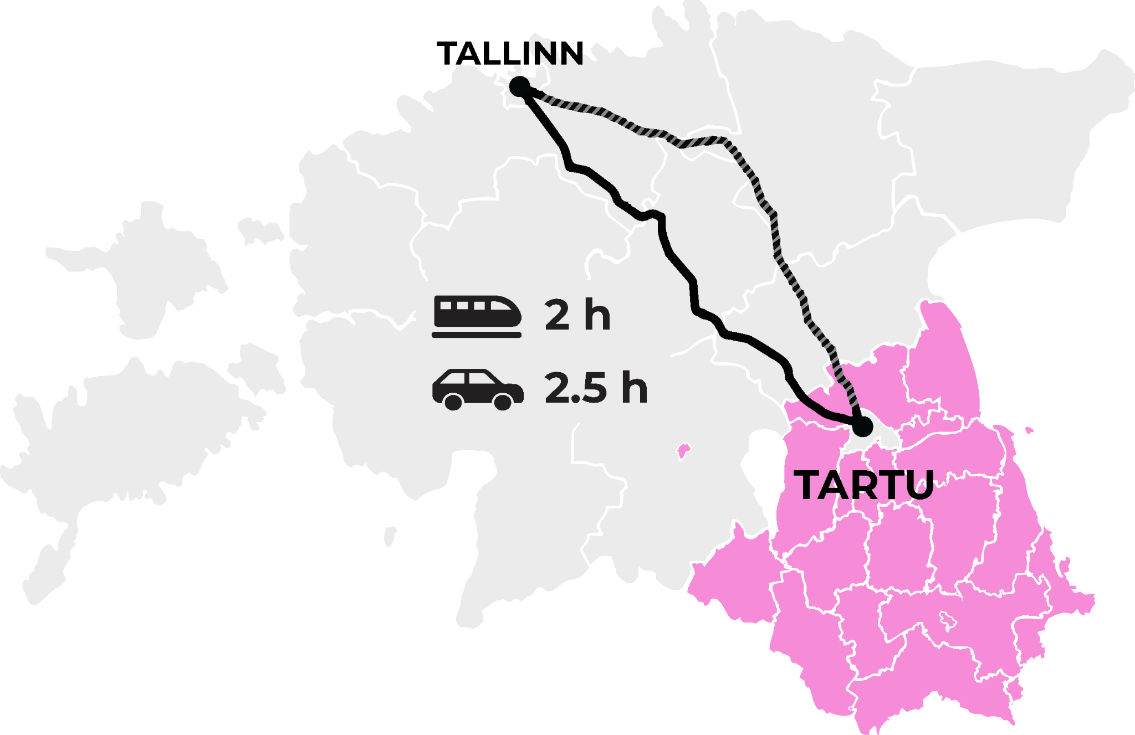
Welcome to
SOUTHERN ESTONIA
264 033 inhabitants
4 counties
11 cities
1 kingdom
5 languages

Slide 3
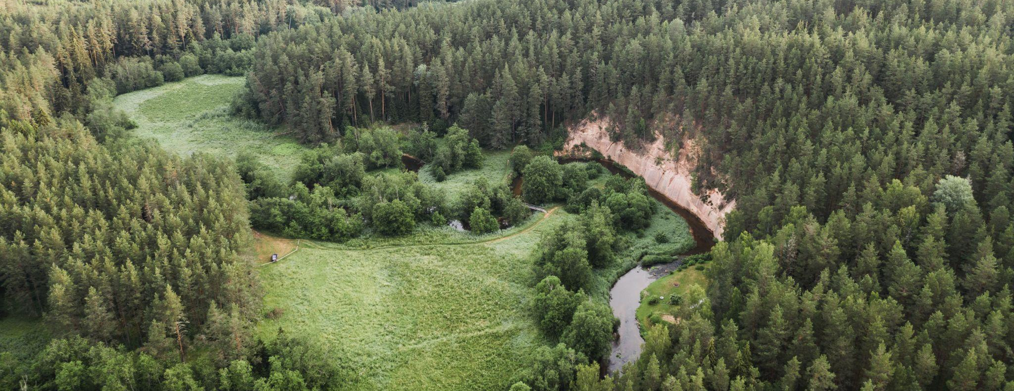
SOUTHERN ESTONIA
Nature Getaway Destination
Rolling hills, deep blue lakes
Karula National Park
Lake Peipus and Võrtsjärv
Munamägi - Highest Peak of the Baltics (318 m)
Taevaskoda Sandstone Outcrops

Slide 4
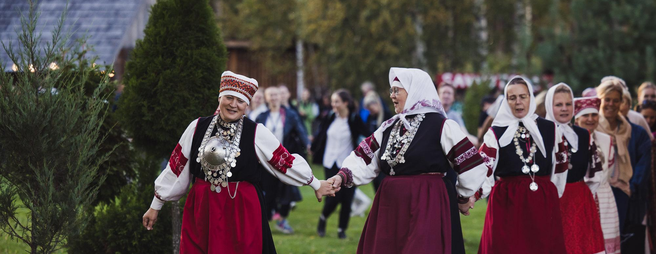
SOUTHERN ESTONIA
Vibrant Heritage
Seto ethnic minority
Old Believers - subgroup of Eastern Orthodox Christians
Smoke Sauna Tradition (UNESCO)
Viljandi - City of Crafts and Folk Art
(UNESCO)

Slide 5
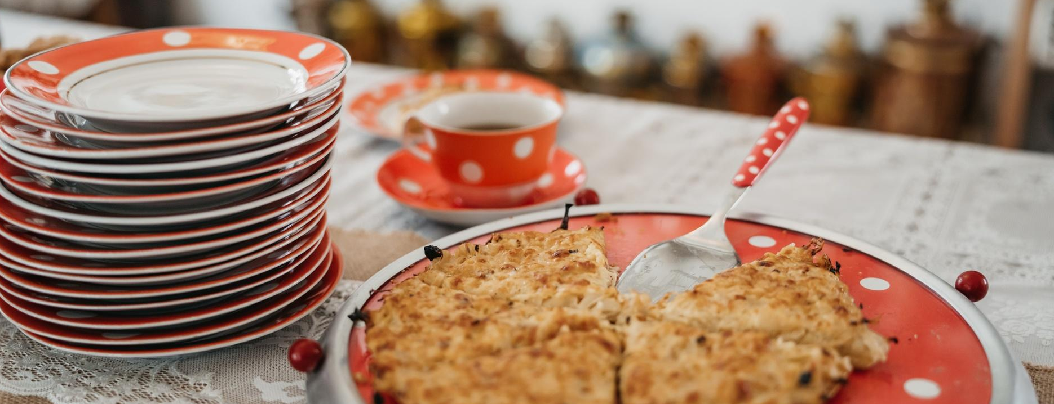
SOUTHERN ESTONIA
Authentic Tastes
Onion Trail Cuisine
“Mulgipuder” - Potatoes and Groats Mash
Hansa - Rye Vodka from Setomaa
Smoked Fish from Lake Võrtsjärv
Peipsi Region Fish Dishes
Home Cafe Days

Slide 6
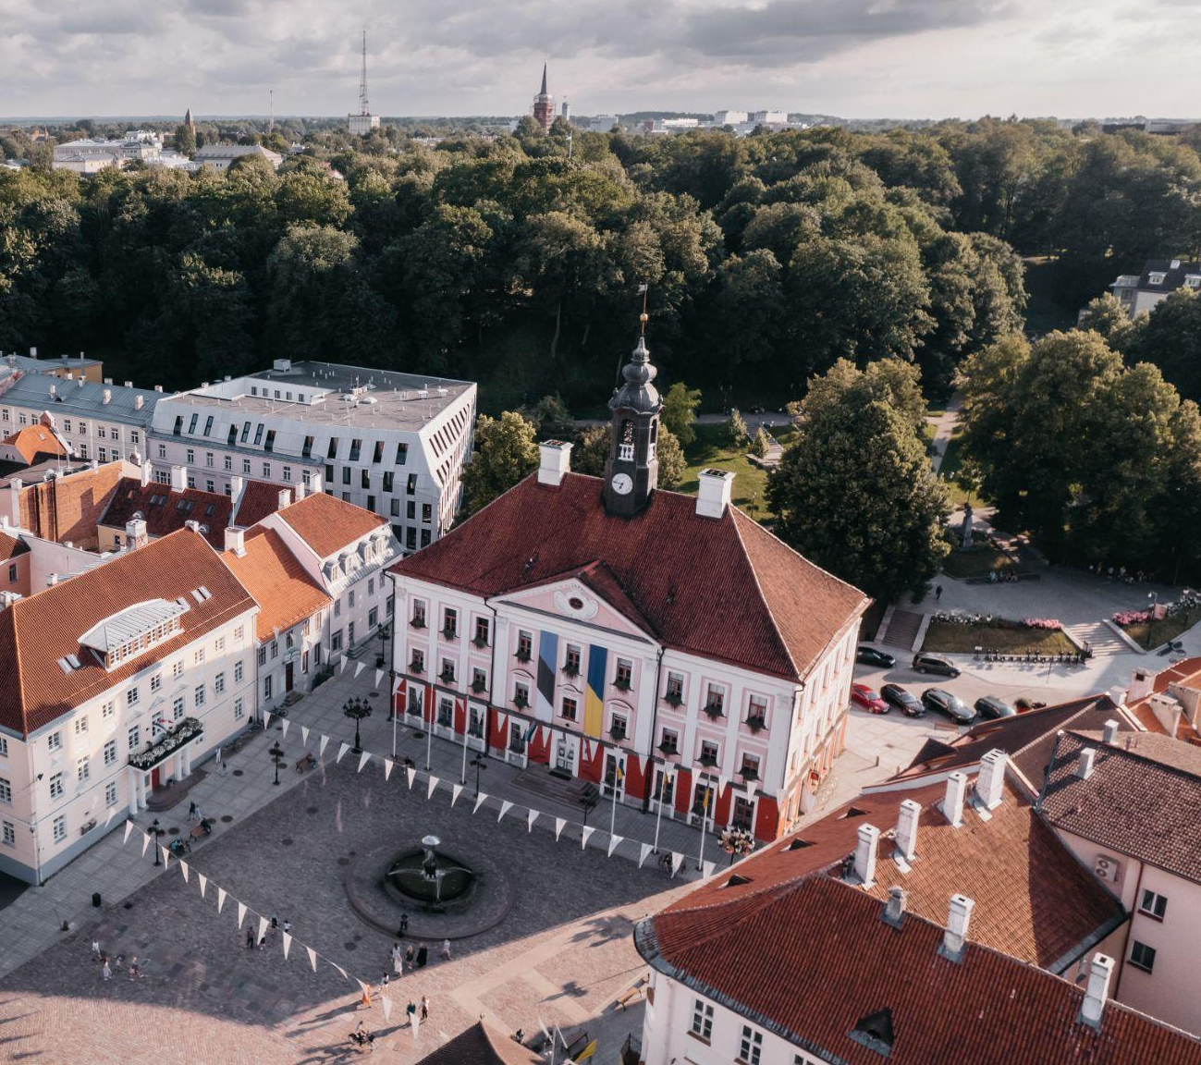
TARTU
Oldest and Smartest
Population: 97 435
The oldest city in the Baltic States, 1030
9 higher education institutes
Cradle of Estonian culture
Among 100 Climate-Neutral European Cities by 2030

Slide 7
TARTU
Historic and Cultural
Hanseatic City
UNESCO’s Creative City of Literature
University of Tartu, 1632
Estonian National Museum
Town Hall Square, Toome Hill
Struve Geodetic Arc

Slide 8
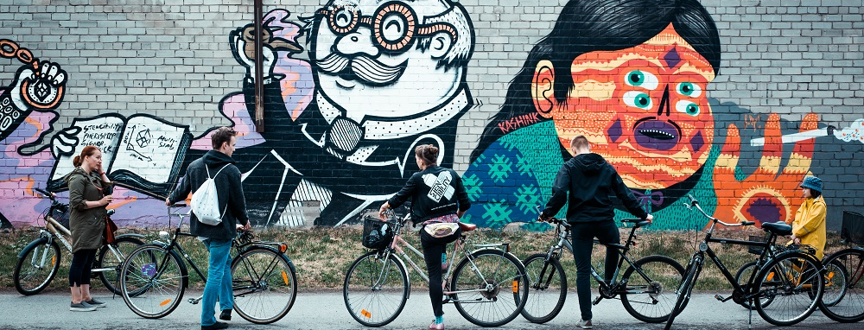
TARTU
Green and Bohemian
Endless City Parks and Murals
Boat Trips on Emajõgi River
Botanical Garden
Creative Centre “Aparaaditehas” (Widget Factory)
Wooden Districts Karlova and Supilinn (Soup Town)

Slide 9
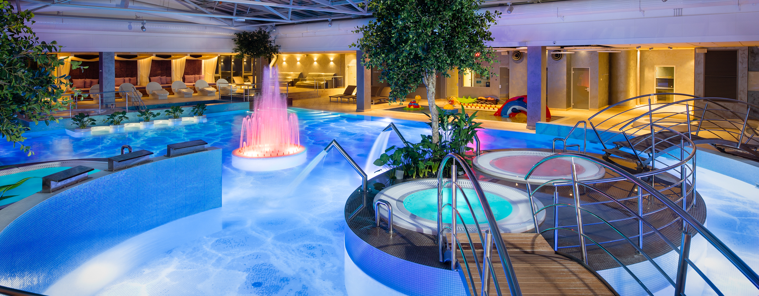
TARTU
Exclusive and Tasty
High Quality Hotels Lydia, V-Spa, Antonius
Spa Resorts
3 Restaurants in Michelin Guide
Peninuki Distillery
A Le Coq Beer Factory and Museum

Slide 10
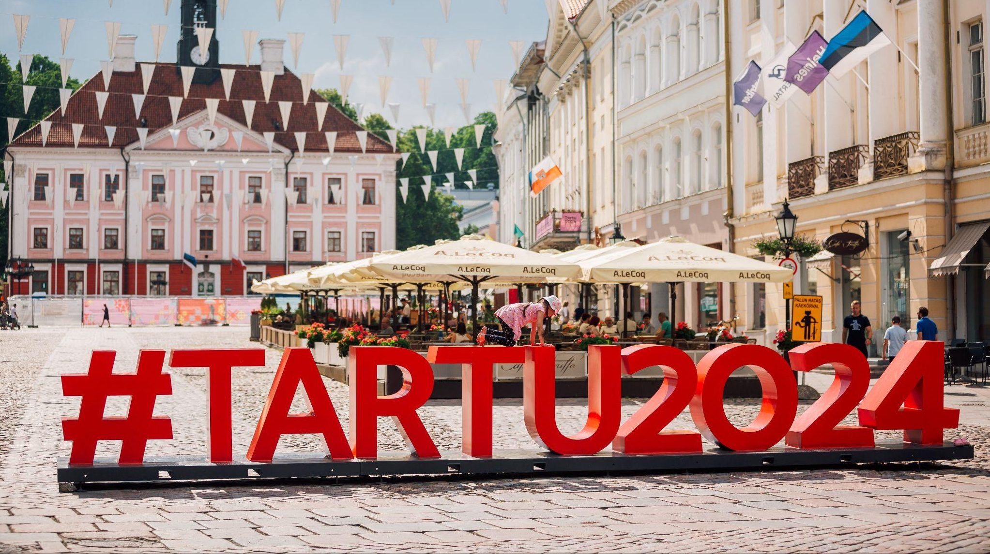
European Capital of Culture
European Capital of Culture

Slide 12
That will lead to nearly
1,000
events!

Slide 13
Tartu 2024 milestone events
26 January The Opening of Tartu 2024
6 July Tartu 2024 Big Summer Celebration
6 July - 11 August Tartu 2024 Car-Free Avenue
30 November The Ending Ceremony of Tartu 2024

Slide 14
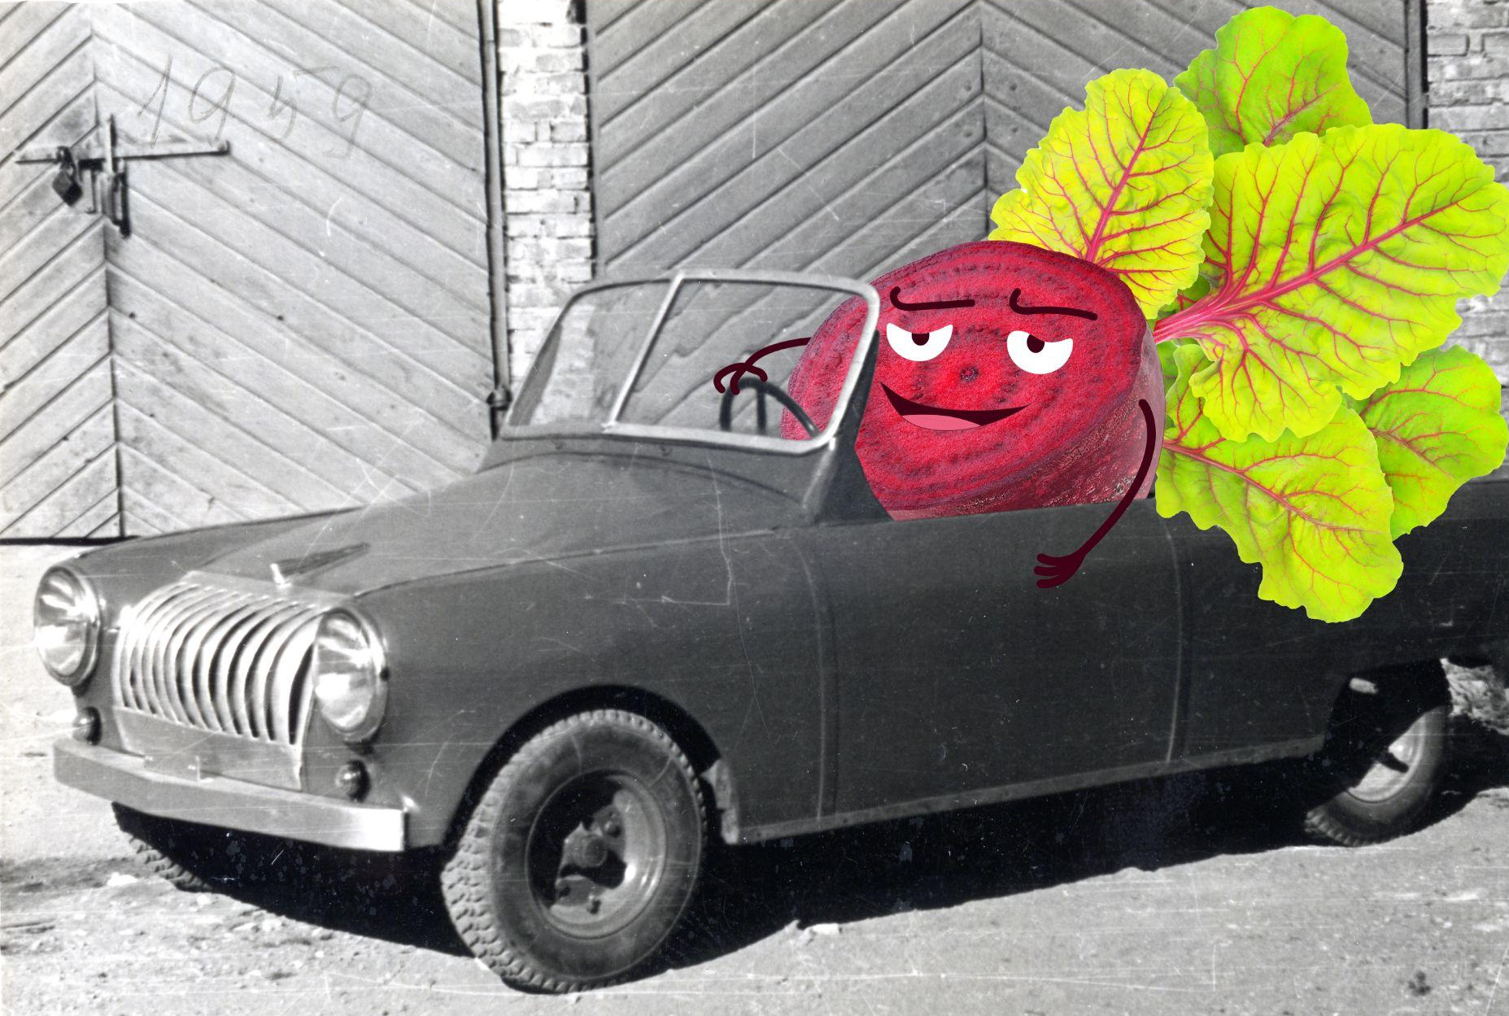
Washing Machine Made of Beetroot
24 April - 31 December 2024
Estonians’ Clever inventions and practices from the Soviet era
Takes place in three museums: Estonian Road Museum, Estonian Agricultural Museum, and Tartu City Museum

Slide 15
Naked Truth
10 -11 May, Tartu Emajõe City Beach
Opinion festival, where sauna benches are
discussion stages
Discussions last 20-30 minutes
Everybody are equal in the saunas
Notes:
Triin muru niitmas pilt

Slide 16
Kissing Tartu
17-18 May – Tartu
A big free concert dedicated to Eurovision and equality
Performers from Estonia and abroad
Culmination is a mass kissing action between the audience members

Slide 17
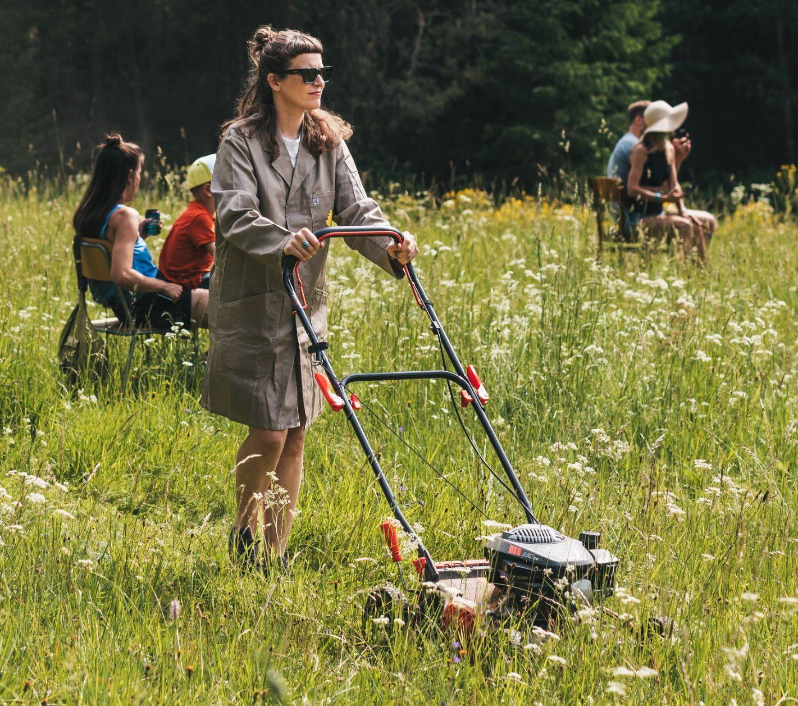
Wild Bits
25 May - 15 September, Otepää municipality
Maajaam ("Earth station") is a tech and art farm near Otepää
An open-air exhibition of technological art where nature and technology blend into one
Notes:
Triin muru niitmas pilt

Slide 18
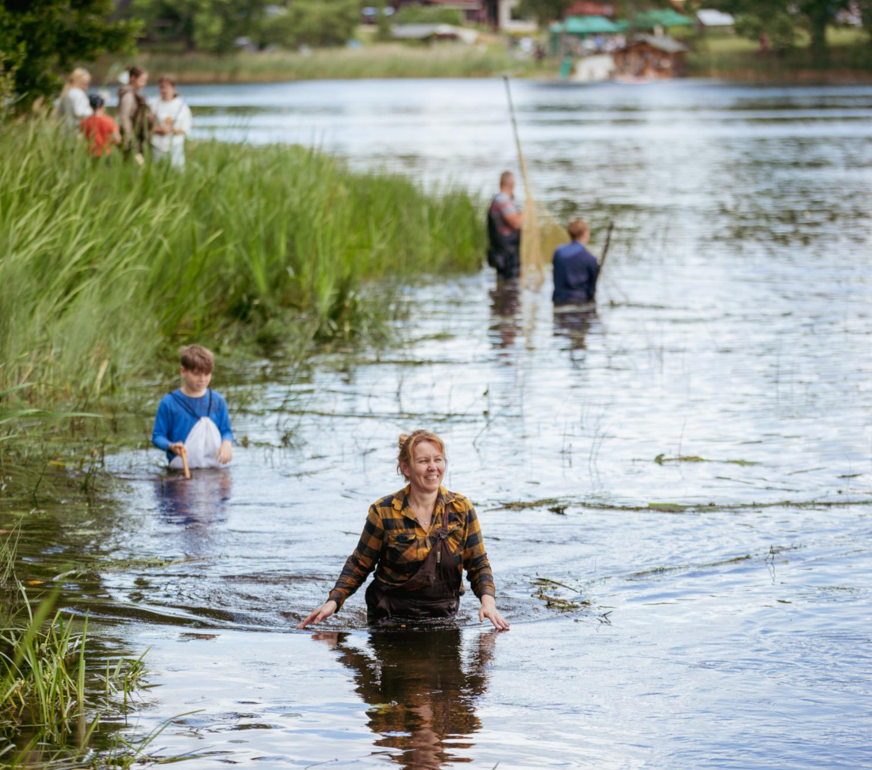
Aigu om!
15-21 July, Rõuge parish
Festival dedicated to “taking time off”
Concerts, forest hikes, cinemas, smoke sauna,
handicrafts, traditional fishing competition
Festival in 2024 is a Japanese edition
Notes:
Triin muru niitmas pilt

Slide 19
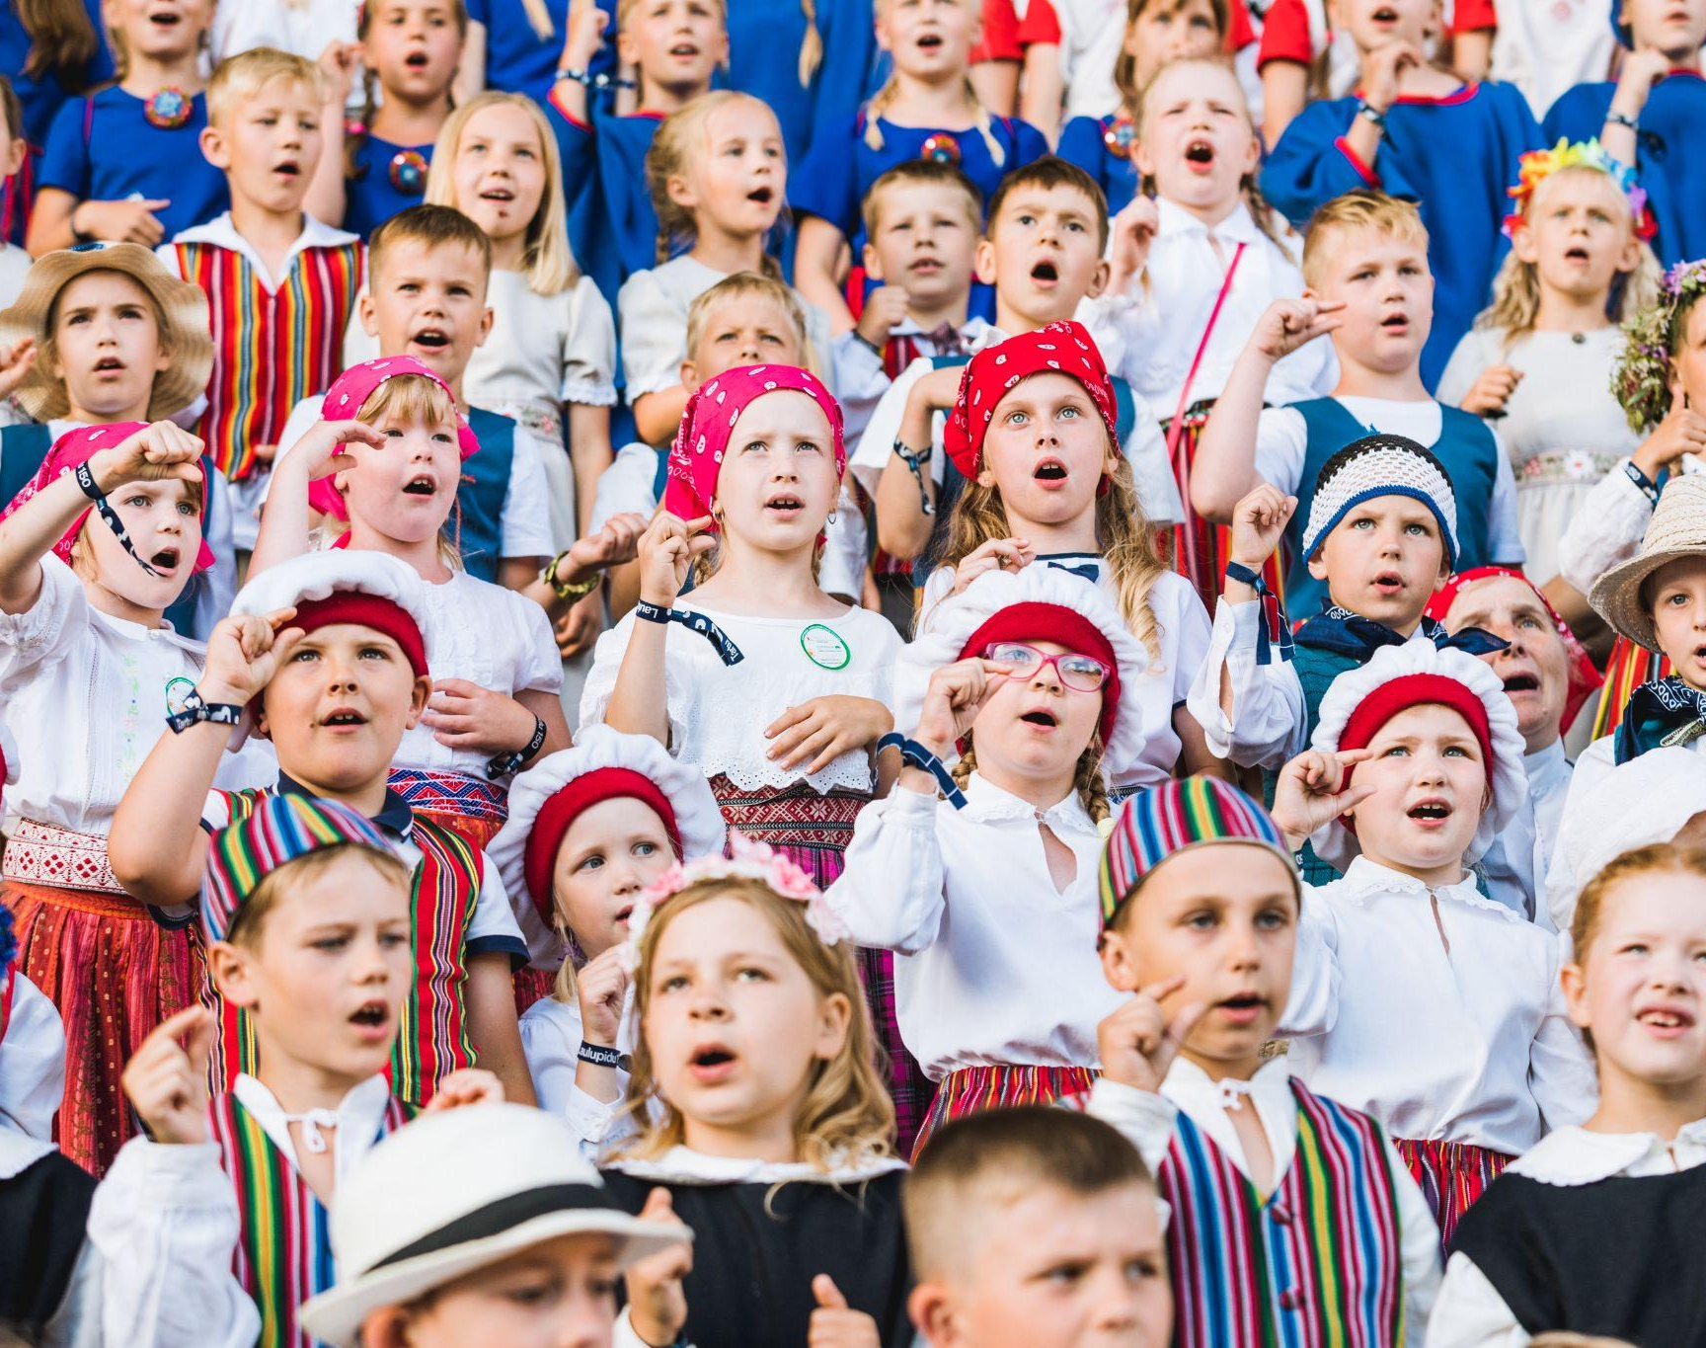
Tartu 2024 Song and Dance Festival
16-22 June – Tartu
155 years from the first ever Estonian Song
16th of June takes place Dance Festival
with more than 2024 international dancers
22nd of June takes place Song festival
with more than 10 000 singers

Slide 20
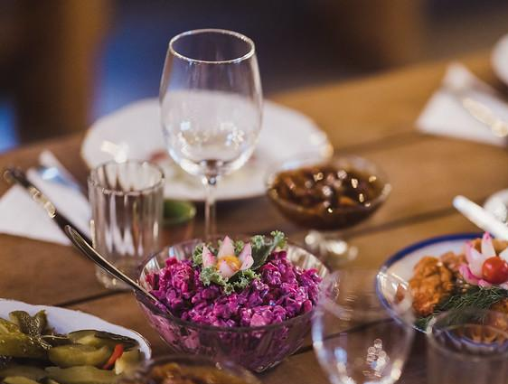
Otepää Beach Gourmet
13-14 September, Otepää
International food and drink festival focusing on local ingredients and traditions
10 restaurants participating in the Pop-up restaurant-street and offering taste experiences
Notes:
Triin muru niitmas pilt

Slide 21
Ryoji Ikeda’s Solo Exhibition
1.11.24-2.3.25 – Tartu, Estonian National Museum
Japan’s leading electronic music
composer and visual artist
Audiovisual installation based on the research
data from the University of Tartu’s Institute of
Genomics
Sound installation created in collaboration
with the Estonian Philharmonic Chamber Choir

Slide 22
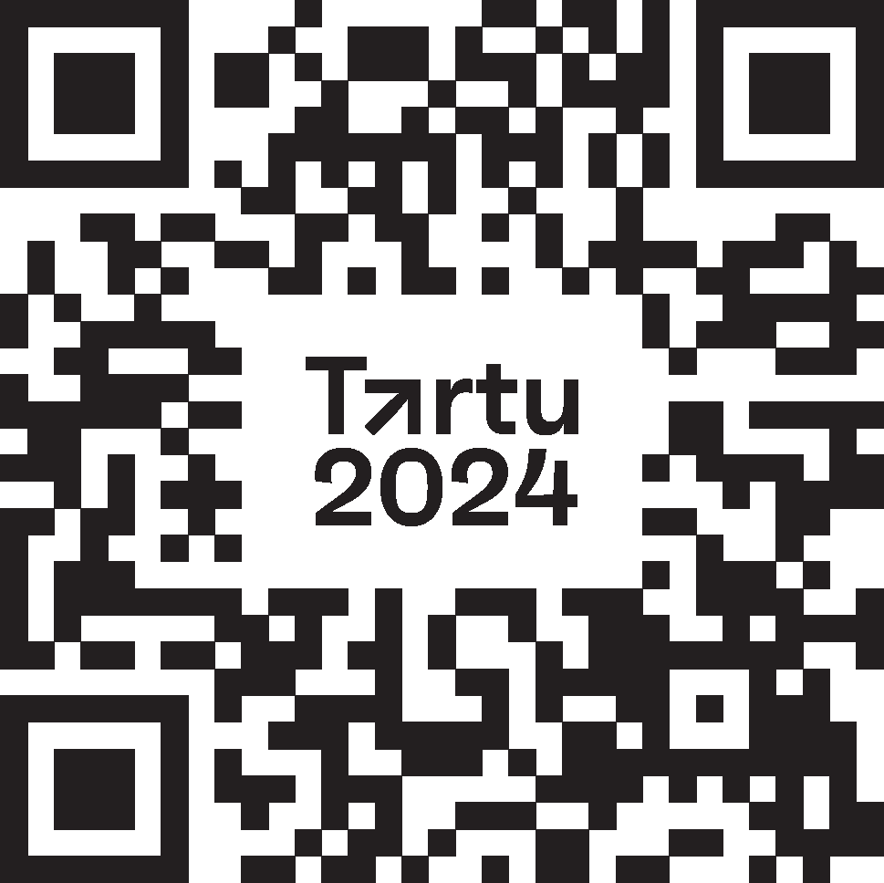
Get ready for a year like no other!
Explore the entire programme

